Slide 1

SWE General Meeting:
May 2nd, 2013

Slide 2
Congratulations New Officers!
Public Relations: Yvette Hernandez
Mentorship Chair: Kiran Saeed

Slide 3
Icebreaker
Marshmallow Tower
Build a structure with:
Marshmallows
Dry spaghetti

Slide 4
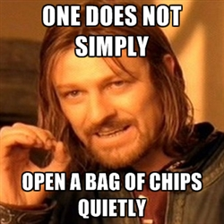
SNACK TIME!

Slide 5
Past Events
Lockheed Martin Day
SWE-OC Conference
Etiquette Dinner
SWEenie RoasTT
Evening With Industry

Slide 6
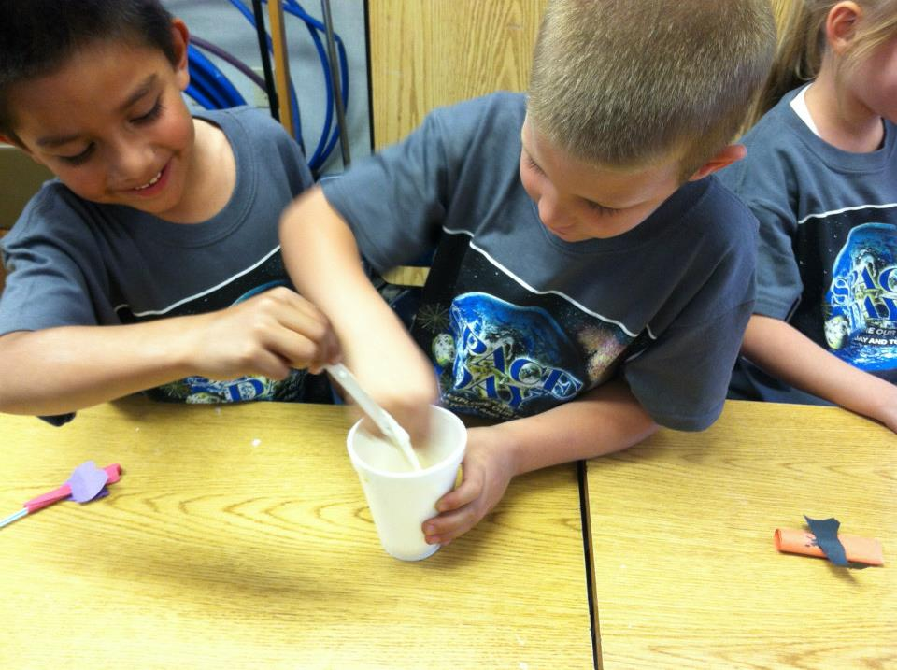
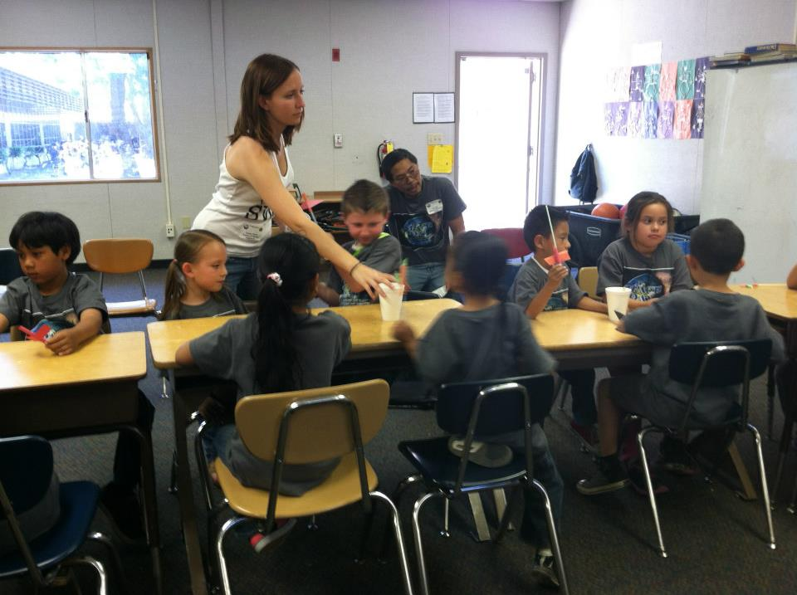
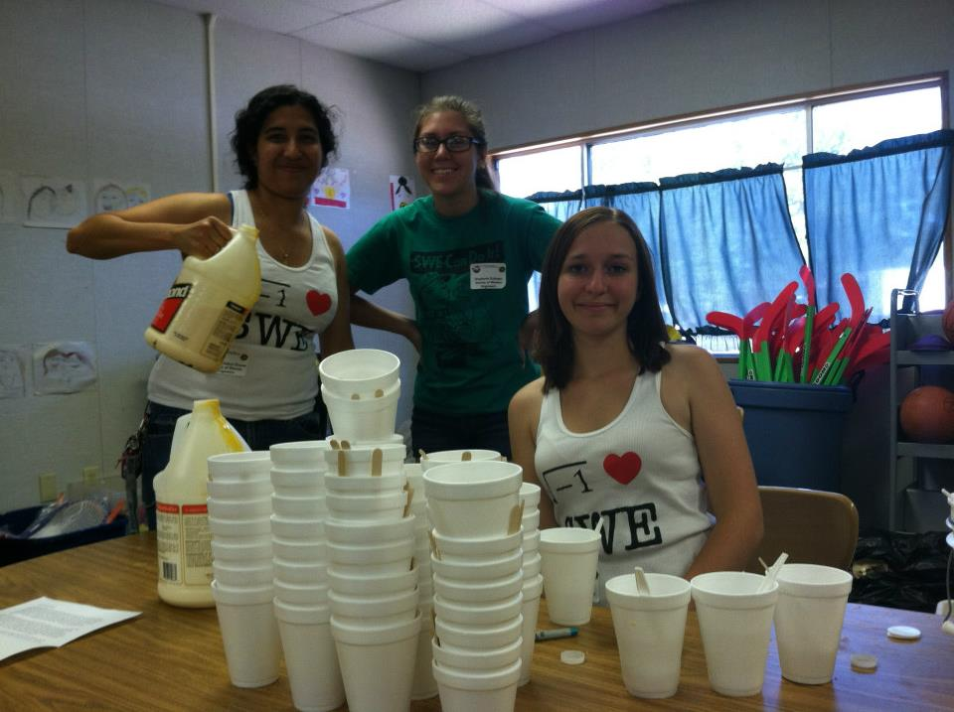
Lockheed Martin Day

Slide 7
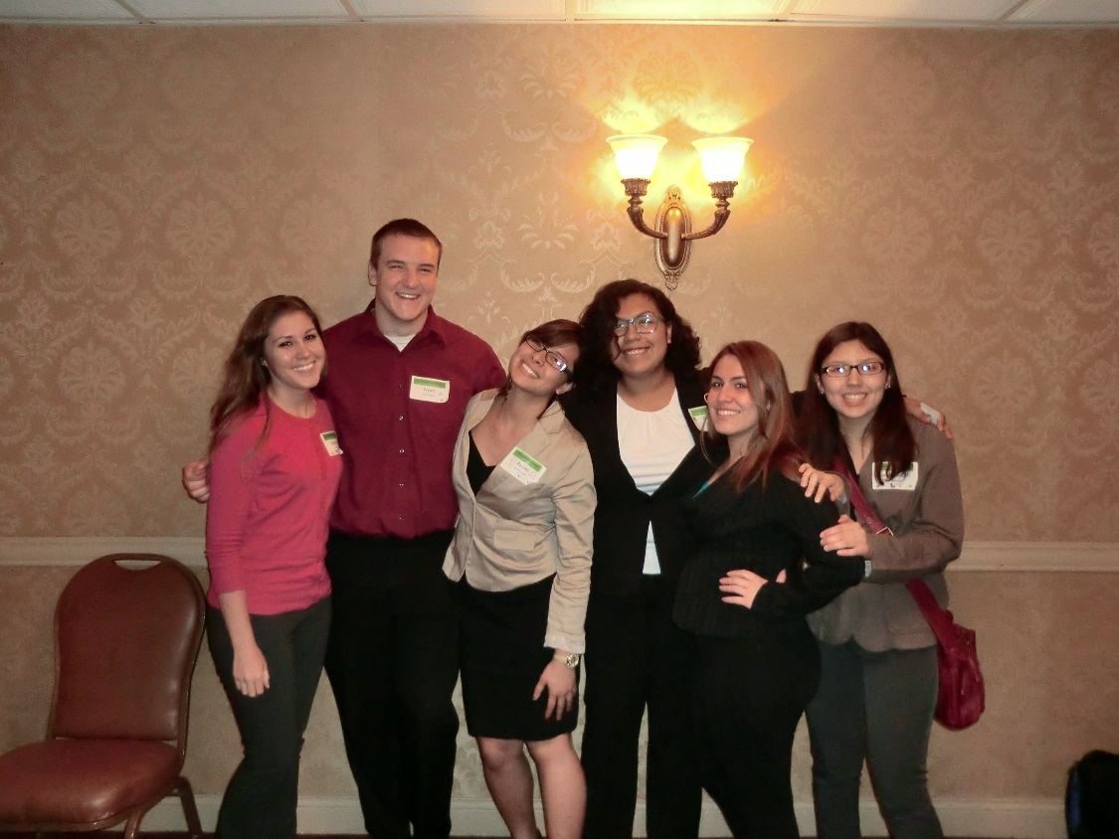
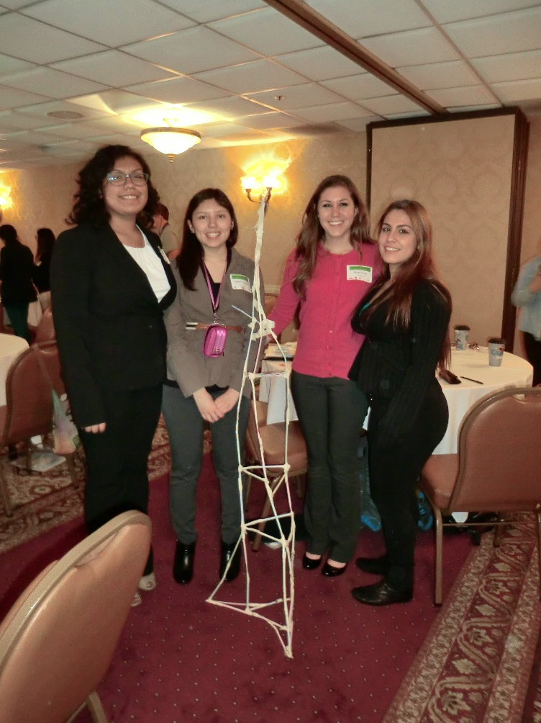
SWE OC Conference

Slide 8
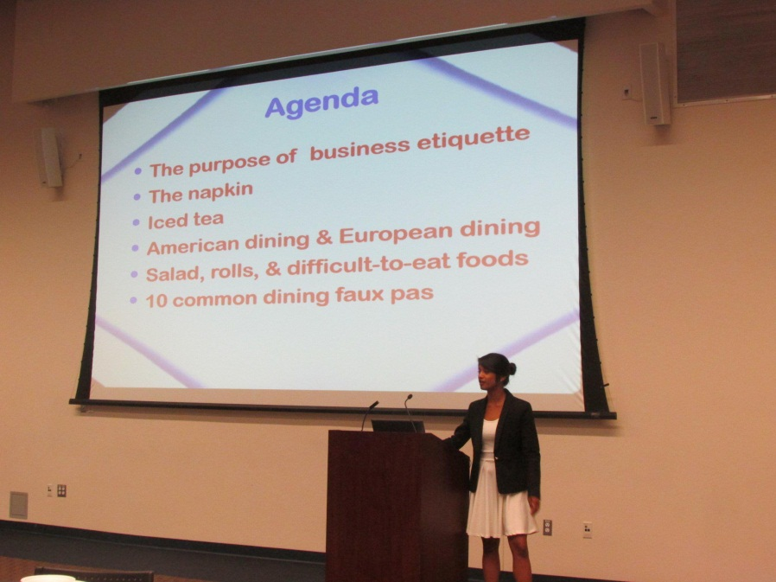
Etiquette Dinner & SWEenie RoasTT with Theta Tau
SWE and Theta Tau teamed up for two events in one day!
In preparation for our EWI we had an etiquette dinner.
We also had a little fun in the sun during last weeks nooner and sold hot dogs galore!

Slide 9

Evening With Industry
THANK YOU EVERYONE WHO CAME TO OUR FIRST ANNUAL EVENING WITH INDUSTRY!!!
AND THANK YOU TO THOSE WHO MADE THIS EVENT POSSIBLE!!!!

Slide 10
Upcoming Events
Event | Date | Location | Time
Bowling Tournament | 5/9/2013 | Moreno Valley Brunswick | 9-12 PM
Lazer Tag | 5/17/2013 | WCH Patio | 7-12 PM
Water Day | 6/1/2013 | AI Lawn | TBD
Bourns Banquet | 6/7/2013 | HUB 302 | 7-11 PM

Slide 11
SHPE Bowling Tournament
Moreno Valley Brunswick
9-12 PM
Join the SWE team!
Lets win this year!

Slide 12
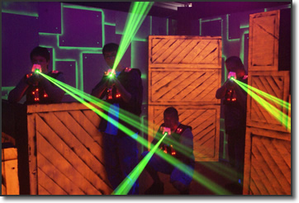
Laser Tag
Tournament Style!
May 17th, 7 PM
Tickets are $5
Food will be provided

Slide 13
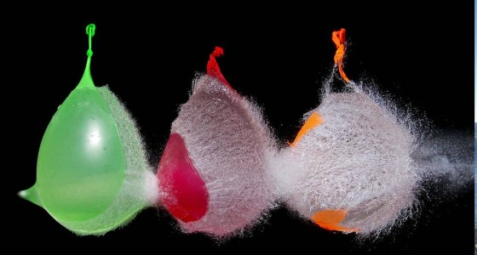
Water Day with IEEE!!!!
Afternoon of June 1st
Fun water activities and food!!

Slide 14
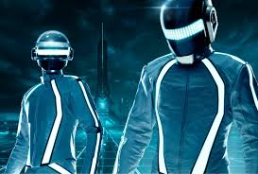

BOURNS LEGACY: INTO THE GRID
This years theme is TRON!
June 7th, 7-11 PM
SWE is in charge of decorating the event, if you would like to be a part of our committee please sign up!
Meetings are at 1pm on Fridays

Slide 15
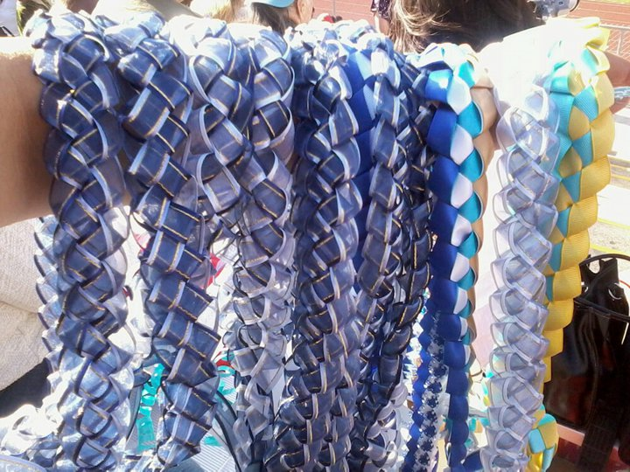
Graduation Leis – Fundraiser!
Do you have a friend who is graduating this spring?
SWE is making ribbon graduation leis in UCR colors and Organization colors!!

